Slide 1
DEBRE MARKOS UNIVERSITY DEBRE MARKOS
INSTITUTE OF TECHNOLOGY SCHOOL OF COMPUTING
SOFTWARE ENGINEERING
System programming group assignment
Group 3
Name ID
Abrham Bitew………………………………………1235
Abebew Mengstie…………………………………..1233
Hana Zeranbesa……………………………………..1264
Aychew agegnew…………………………………..1246
Yohannes Endeshaw……………………………….1291

Slide 2
Contents
Text editors
Introduction
Overview of the Editing Process
Editor Structure
Debugging System
Interactive Debugging Systems
Debugging functions and capabilities
What type of debugging system used
User Interface
Overview of User interface
Create a User Interface
List User Interface Criteria(UIC)
Evaluate your interface based on the (UIC)

Slide 3
Sublime Text Editor :- Introduction
Sublime Text Editor is a full featured Text editor for editing local files or a code base. It includes various features for editing code base which helps developers to keep track of changes. Various features that are supported by Sublime are as follows
Syntax Highlight
Auto Indentation
File Type Recognition
Sidebar with files of mentioned directory
Plug-in and Packages
Sublime Text is a fast, powerful and easily extensible code editor. like Visual Studio code and NetBeans.

Slide 4
Sublime Text Editor :- Overview of the Editing Process
An interactive editor is a computer program that allows a user to create and revise a target document.
Document includes objects such as computer diagrams, text, equations tables, diagrams, line art. Here we restrict to text editors, where character strings are the primary elements of the target text.
Document-editing process in an interactive user-computer dialogue
Select the part of the target document to be viewed and manipulated.
Update the view appropriately.
Determine how to format
We Can
Insert, delete, replace, move, copy, cut, paste, etc...
Traveling:-locate the area of File.

Slide 5
..Cont
Sublime Text is a Type of Screen editors
Screen editors: In this type of editors, the user is able to see the cursor on the screen and can make a copy, cut, paste operation easily. It is very easy to use mouse pointer.
We can not insert image or videos in text like MS Word but we can open image in Sublime Text

Slide 6
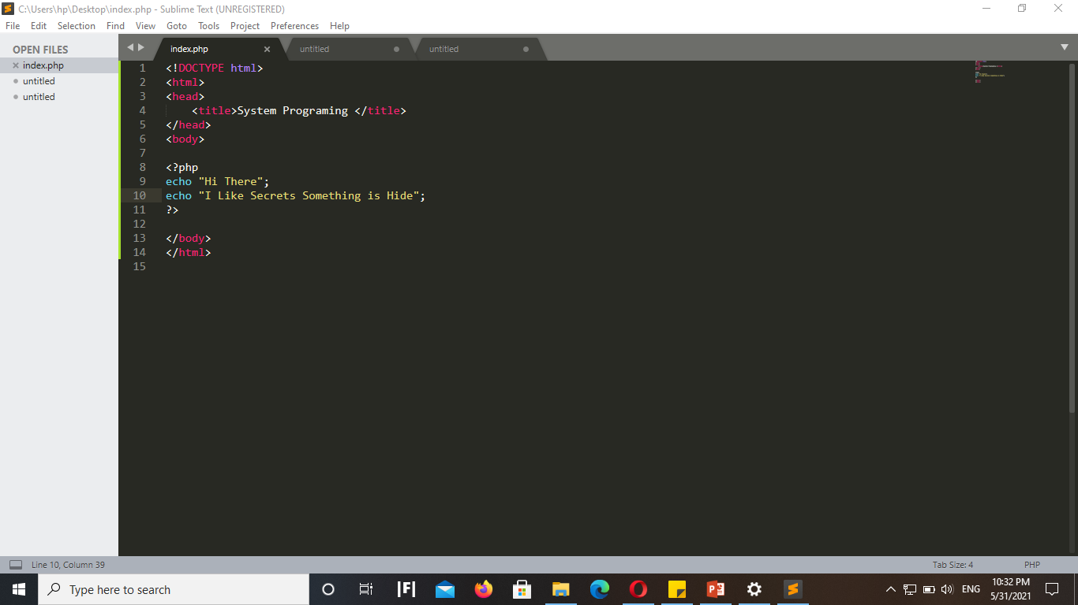
Sublime Text Editor :- Editor Structure

Slide 7
Sublime Text Features :-
"Goto Anything," quick navigation to files, symbols, or lines
"Command palette" uses adaptive matching for quick keyboard invocation of arbitrary commands
Extensive customizability via JSON settings files, including project-specific and platform-specific settings
Python-based plugin API
Compatible with many language

Slide 8
Interactive Debugging Systems
An interactive debugging system provides programmers with facilities that aid in the testing and debugging of programs
Debugging is the process of finding errors and bugs in the given code and fixing them.
Sublime editor includes various plugins that have debugging features, which helps in finding errors easily.
Example
Sublime uses Sublime Xdebug debug plugin for debugging the PHP files and scripts.

Slide 9
Debugging functions and capabilities
A Debugging system should also provide functions such as tracing and trace back.
Tracing can be used to track the flow of execution logic and data modifications.
The control flow can be traced at different levels of detail – procedure, branch, individual instruction, and so on…
Trace back can show the path by which the current statement in the program was reached.
It can also show which statements have modified a given variable or parameter.
The statements are displayed rather than as hexadecimal displacements

Slide 10
What type of debugging system used ?
Debugging is the process of finding errors and bugs in the given code and fixing them. Sublime editor includes various plugins that have debugging features, which helps in finding errors easily.
Sublime Text Editor has a plugin Web Inspector for debugging JavaScript code. It helps us to set breakpoints
Sublime Text Editor has a plugin Xdebug for debugging Php code. It helps us to set breakpoints
Etc..
Both Xdebug and Web Inspector are plugin.

Slide 11
Overview of User interface
A user interface is the means by which a human and a computer system interact.
User interfaces are composed of one or more layers including a human-machine interface (HMI) using physical input devices such as keyboards, mice, and game pads as well as output hardware such as computer monitors, speakers, and printers.
The goal is to enable the user to operate and control the machine in order to effectively complete a task and receive feedback that makes the decision-making process easier.

Slide 12
List User Interface Criteria(UIC)
Simplicity :
User Interface design should be simple
Less number of mouse clicks and keystrokes are required to accomplish this task
Consistency :
The user interface should have a more consistency
We should apply typeface, style and size convention in a consistent manner to all screen.
Prevention :
A good user interface design should prevents users from performing an inappropriate task and this is accomplished by disabling certain elements under certain conditions
Forgiveness :
This quality can encourage users to use the software in a full extent.
Designers should provide users with a way out when users find themselves somewhere they should go

